Slide 1
AQI Database
Air Quality Index Database
By: Eric Li, Harjot Grewal

Slide 2
System Description
Create a web app that allows users to see and interact with the AQI information of various countries
User can add, delete, or modify information in the database
User add new data by inputting the date, country’s name, air quality status, and AQI score
Can also add multiple new info at once via an excel sheet

Slide 3
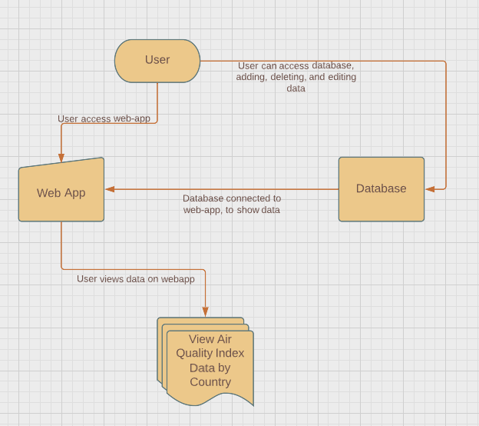
Use Case Diagram

Slide 4
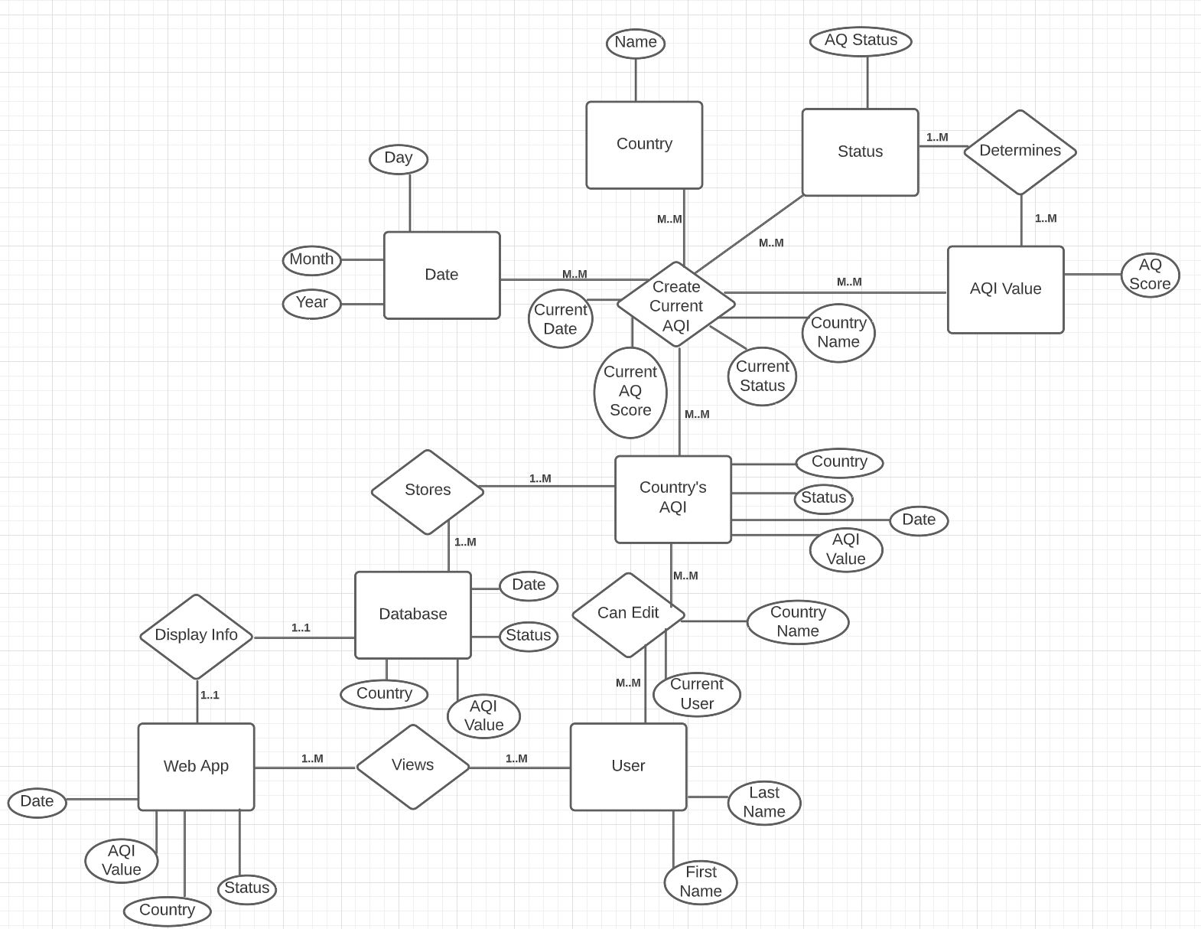
E/R Diagram

Slide 5
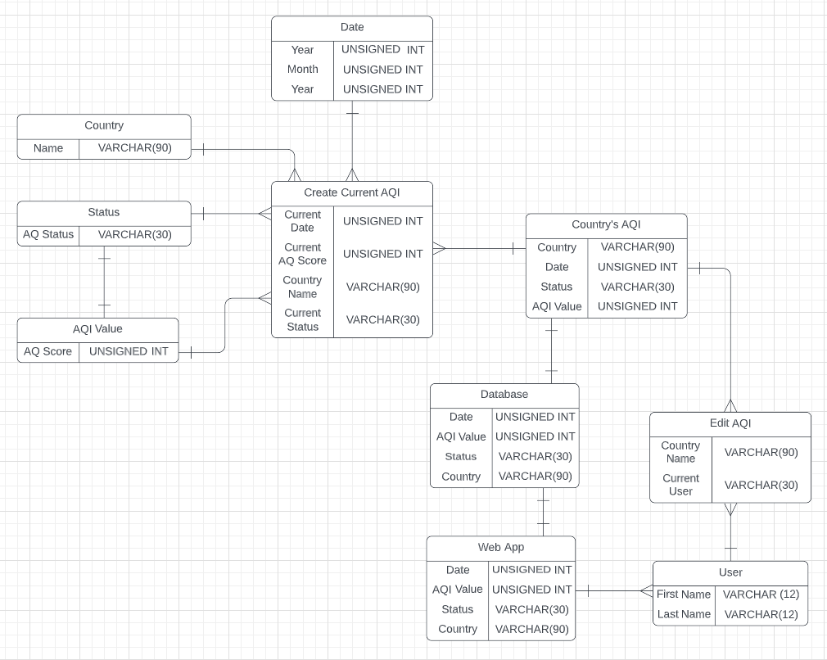
Relational
Schema

Slide 6
Implementation Details
Front-end
Bootstrap
HTML5
Javascript
Back-end
SQLite
Node.js

Slide 7
Thank You!
Any Questions?
Github Link: https://github.com/Jothu16/CSE111Project

